Slide 1

Academic Year 2022-2023 USER AUTHENTICATION SYSTEM IN C
GUIDED BY PRESENTED BY
Mr. Manjunatha Swamy Sir KAZI AFROZ ALAM
Senior Associate Professor/CSE USN-1NH21CS129
III-B

Slide 2
ABSTRACT
With the rapid evolution of the wireless communication technology, user authentication is important in order to ensure the security of the wireless communication technology. Password play an important role in the process of authentication. In the process of authentication, the password enter by the user will be transmitted along the traffic to the authentication server in order to allow the server to grant access to the authorised user. The attackers will use the chance to attempt to sniff others person password in order to perform some illegal activities by using other's identity to keep them safe from trouble. Due to the issues, there are many solutions has been proposed to improve the security of wireless communication technology. The objective of the system outcome is to enhance the current login authentication system. It provides solutions for making password breaking more difficult as well as convinces users to choose and set hard-to-break passwords.

Slide 3
OBJECTIVES
The objectives of this code are to:
Provide a registration process for users to sign up and create a user account.
Implement a login system for users to enter their credentials (username and password) and gain access to the system.
Check the validity of the user's credentials against the information stored in a password file "passwd.txt".
Display the result of the login process (successful or unsuccessful) and redirect the user to the main menu.
Offer options for the user to logout, exit the program, or return to the main menu.

Slide 4
PROBLEM DEFINITION
The problem definition for this user authentication system code is to provide a secure mechanism for verifying the identity of users accessing a system or service. The code aims to ensure that only authorized users are able to access the system and that the user's identity is kept confidential. The system should be able to authenticate users based on their username and password, and also possibly through additional authentication methods such as multi-factor authentication.

Slide 5
REQUIREMENTS
Hardware Requirements:
1. Intel Pentium Pro Processor or later.
2. RAM 512MB or more.
3. Storage of 128GB or more.
Software Requirements:
1. Windows 7 32 bit/64 bit or above.
2. C Language Version.

Slide 6
DESIGN
The design of a user authentication system code typically includes the following elements:-
User registration: It is a process where new users can create an account with the system by providing personal information, such as username and password.
Login: It is a process where users can enter their username and password to gain access to the system.
Session management: It is a process that keeps track of a user’s session and logs them out after a certain amount of time has passed or when they log out manually.
Password management: It is a process that stores passwords securely and implements policies for password strength and password resetting.
Authorization: It is a process that checks if a user has the proper permissions to access specific resources within the system.
Error handling: It is a process that provides appropriate error messages when errors occur during the authentication process, such as incorrect login credentials.
Logging: It is a process that tracks user activity and records events, such as successful logins and failed login attempts.
This design can be implemented using various programming languages, frameworks, and libraries.

Slide 7
ALGORITHM
Step1: Display in console the Login/Registration menu (1. Register, 2. Login, 3. Logout, 4. Exit)
Step2: Enter choice.
Step4: Check if choice is equal to 3 (Logout), then set login_mask to 7 otherwise go to Step5
Step5: choice = choice & login_mask
Step6: check if choice is equal to 1, then go to Step10, otherwise go to Step7
Step7: Check if choice is equal to 2, then go to Step14, otherwise go to Step8
Step8: Check if choice is equal to 3, then go to Step22, otherwise go to Step9
Step9: Check if choice is equal to 4, then go to Step23, otherwise go to Step2
Step10: Registration Operation, open “password.txt” file

Slide 8
ALGORITHM
Step11: Take “First Name” & “Surname” inputs from Console
Step12: Create a user ID by taking “User Name” and “Password” from console
Step13: Update/Save/Store “password.txt” file with “First Name”, “Surname”, “User Name”, & “Password”. Go to Step14
Step14: Login Operation, open “password.txt” file to read password details for a user
Step15: Enter “User Name” & “Password” form console
Step16: Read all the user details (“User Name” & “Password” from “password.txt”)
Step17: Check whether the “User Name” & “Password” taken as input from console are matching with the one of the entry stored in the “password.txt” file? If matching then go to Step 20, otherwise go to Step21
Step18: Set login_mask = 0, go to Step2

Slide 9
ALGORITHM
Step19: Set login_mask = 7, go to Step2
Step20: Logout Operation, set login_mask = 7 and go to Step2
Step21: Exit

Slide 10
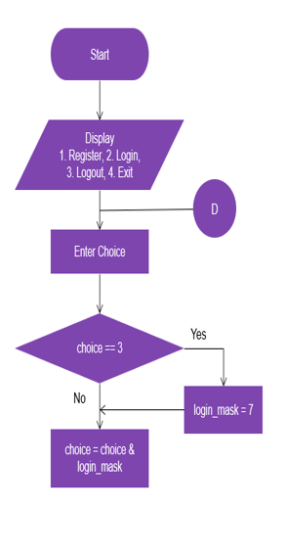
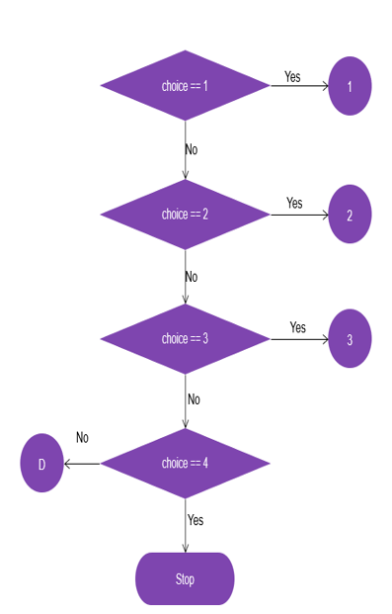
FLOWCHART

Slide 11
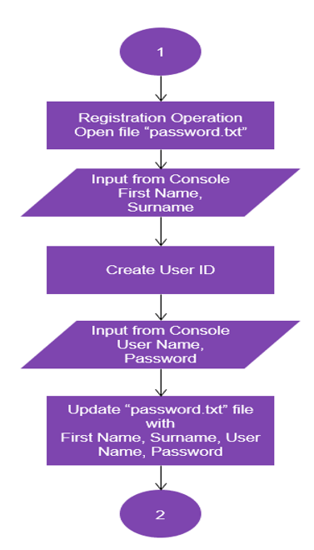
FLOWCHART

Slide 12
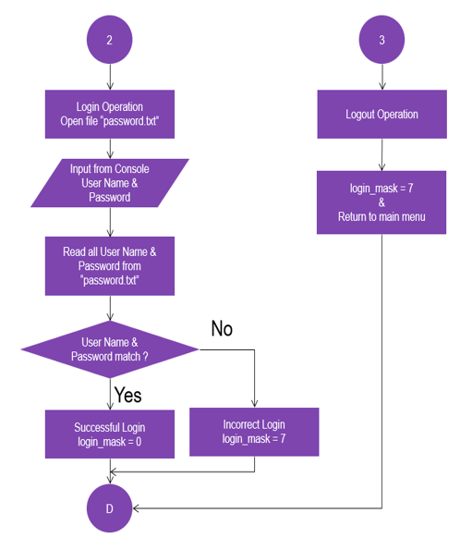
FLOWCHART

Slide 13
METHODOLOGY
The user will start by entering his username and can either choose to login or signup. If the user is already registered then he/she can choose to login else he/she is first asked to sign up. If the user is new then he/she has to enter their username and signup.
When the user opts for sign up he will be put into a virtual world when the user has to interact with the objects present in the virtual world to make his password. The user has to make a sequence pattern by displacing the objects from one position to another. This sequence pattern will be then set as his/her password.
If the user has already signed up and wants to login then he can enter his/her name and opt for login. The user will then be put into the same virtual world where he/she had created the password and the user will have to enter his/her original sequence pattern of object displacement in order to authenticate himself/herself.
The sequence pattern and the object displacement position entered by the user will be then matched with the original password created by the user during the signup. If the sequence pattern and the displacement position matches with that entered by the user, then the user will be authenticated else he has to re-enter the password.

Slide 14
IMPLEMENTATION ROADMAP
Registration MODULE
Login MODULE
Logout MODULE
Exit MODULE

Slide 15
IMPLEMENTATION ROADMAP
The implementation roadmap for this code is as follows:-
Start by understanding the data structures used in the code such as the "login" structure.
Understand the functions in the code, including "enter_login", "registration", and "clear_input_stream".
Study the main function, which implements the menu-driven system. This is where all the functions are called.
Test the code and check for any bugs or issues.
Refine and optimize the code, if needed.
Document the code.

Slide 16
CODE IMPLEMENTATION MODULE
This code is a simple user registration and login system written in C. The code implements a menu-driven system where the user can select one of the following options:-
Register: The user can enter his/her personal information and choose a username and password for the system. This information is stored in a text file called "passwd.txt".
Login: The user is prompted to enter their username and password. The code then reads the information from the "passwd.txt" file and compares it with the input. If the information matches, the user is granted access.
Logout: The user is logged out of the system.
Exit: The program exits.

Slide 17
DRAWBACKS OF AUTHENTICATION SYSTEM
There are many authentication techniques available, such as textual password, Graphical password, etc. but each of this individually having some limitations & drawbacks.
Current authentication systems suffer from many weaknesses. Textual passwords are commonly used; however, users do not follow their requirements.
Users face difficulty in remembering a long and random appearing password and because of that, they create small, simple, and insecure passwords that are easy to attack.
Users tend to choose meaningful words from dictionaries, which make textual passwords easy to break and vulnerable to dictionary or bruteforce attacks.
Many available graphical passwords have a password space that is less than or equal to the textual password space.
With the development by means of technology, it has become very easy for others to hack someone’s password.

Slide 18
CONCLUSION
This project has been developed successfully and the performance of the system has been found satisfactory.
Use of this interface helps Users in having immediate information about login system and register/login their account secure and safe .
User friendly Interface also for the admin to login and use the login system smoothly with full information about their login details.

Slide 19
Contd..
The proposed system developed will provide a new perspective when it comes to user authentication. The system can be more secure than currently existing user authentication systems.
As the user would be wearing a Head Mounted Display, there is no way that any other person present around would know what the user would be doing in the virtual world, making it difficult to replicate the password.
Also, the user will find the environment comforting and password remembrance easy.
Even if someone wears the headset to perform the actions it would be almost impossible to perform the same action due to spawning and objects used for the password by the user.
The constraints of the VR technology and Headsets may make authentication process time increase, but also gives a sense of increased security.

Slide 20
FUTURE PREDICTIONS
The project coding can be very easy to handle the further modifications in the future.
It is much more understandable and can be modified in future according to the future and as per their needs.
However, based on the code, this code can be improved in terms of security, such as by using hashing or encryption for storing passwords, improving input validation to prevent against buffer overflow attacks, or using better authentication mechanisms.
Additionally, the code can be enhanced to provide better user experience and interface, or to support additional features and functionalities.

Slide 21


